Slide 1
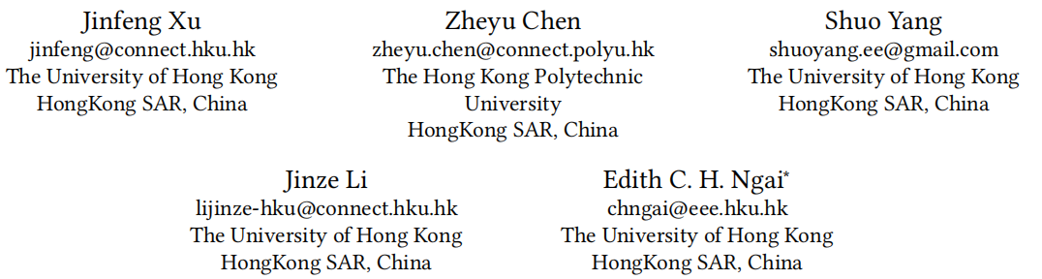



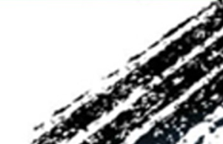

The Best is Yet to Come: Graph Convolution in the Testing Phase for Multimodal Recommendation
（MM-2025)
Reported by Jiale Shen

Slide 2
motivation
C1: GCNs inevitably create unhelpful or even harmful positive and negative pairs during model optimization.
C2: GCNs isolate different modalities, resulting in sub-optimal recommendation performance
C1
U1
U1
i1
i1
i2
U2
U2
i2
i3
i4
C2
img txt semantics
i1 <red dress > Red gown semantic consistency
i2 < red dress > Stage performance costume semantic inconsistency
i1 ≈ i2

Slide 3
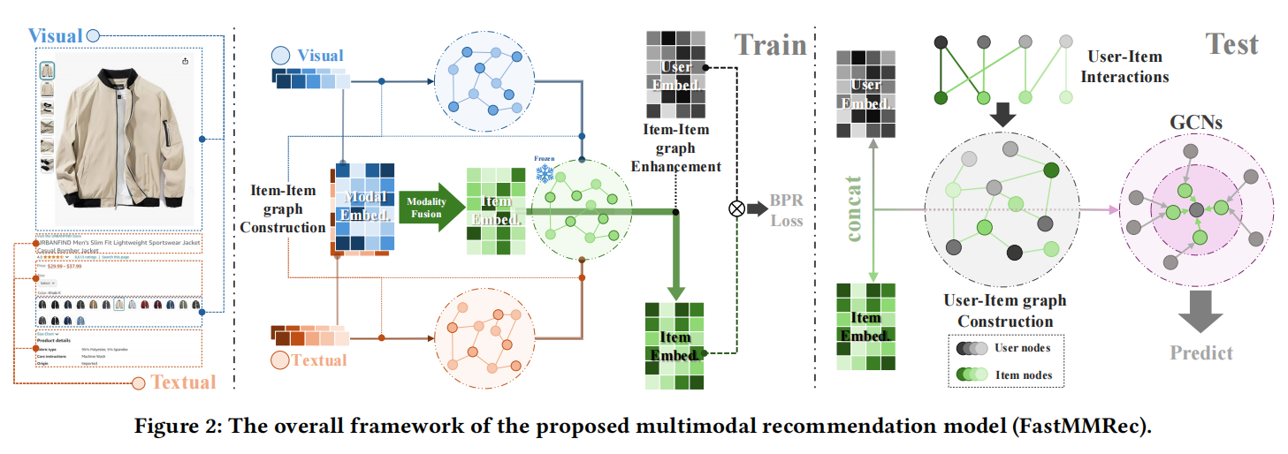
Overview
2025_MM_The Best is Yet to Come: Graph Convolution in the Testing Phase for Multimodal Recommendation

Slide 4
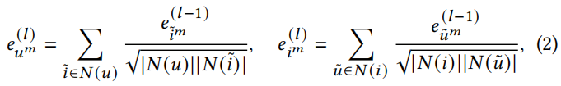

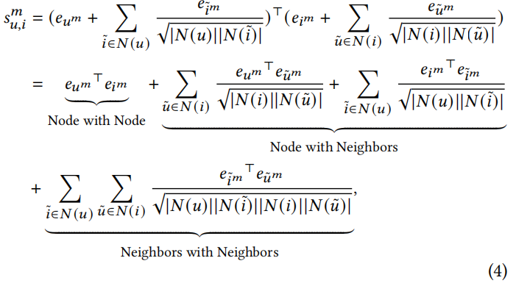
Approach
U1
U3
i1
U2
i3
i2
U4

Slide 5


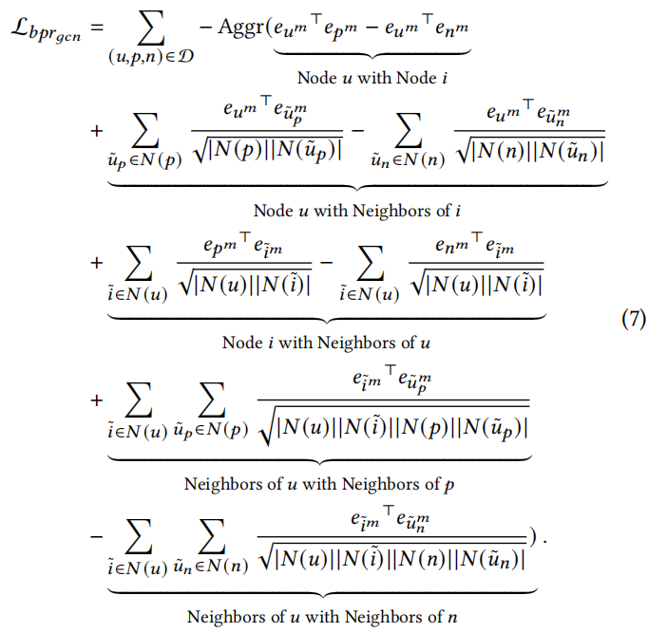
Approach
U1
U3
i1
U2
i3
i2
U4

Slide 6

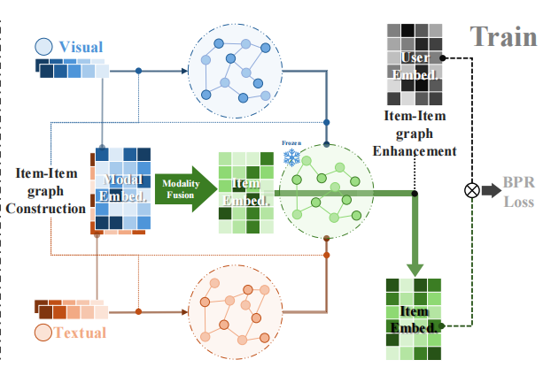





Approach

Slide 7
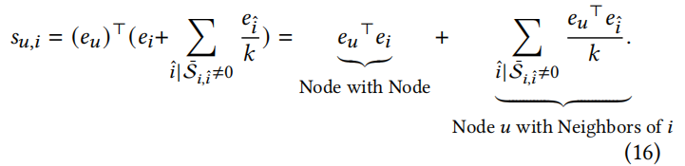
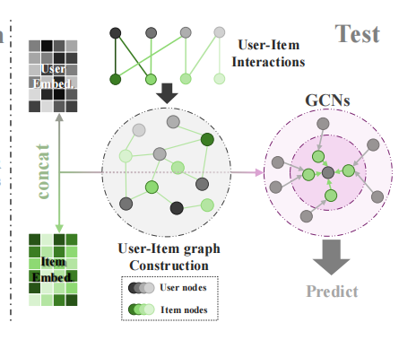
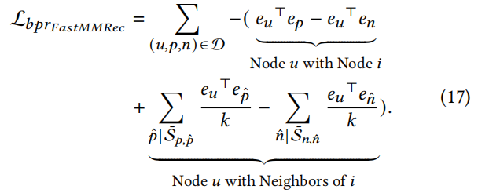
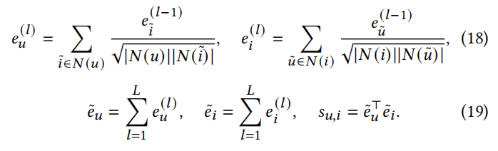
Approach

Slide 8
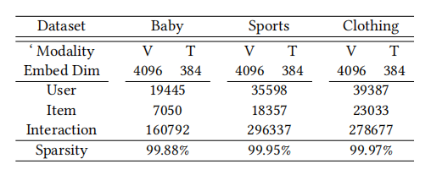
Experiment

Slide 9
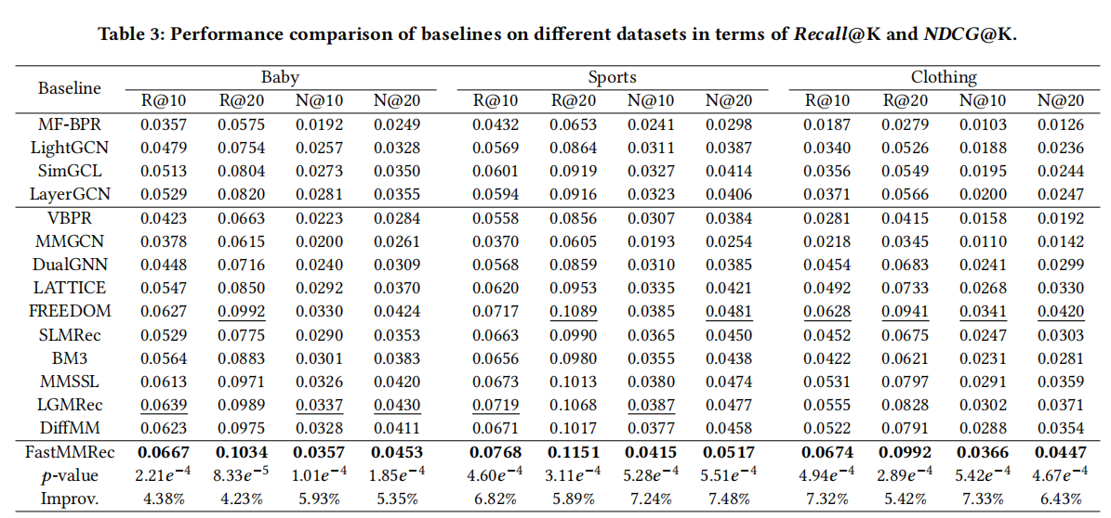
Experiment

Slide 10
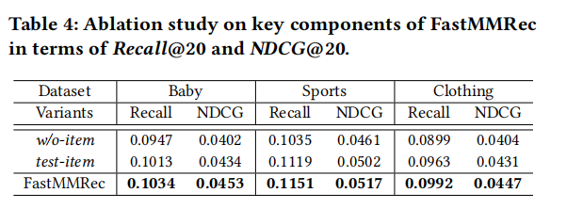
Experiment

Slide 11
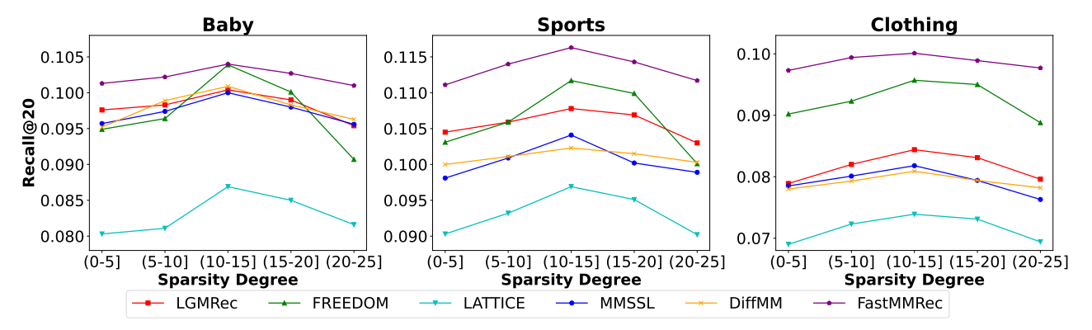
Experiment

Slide 12
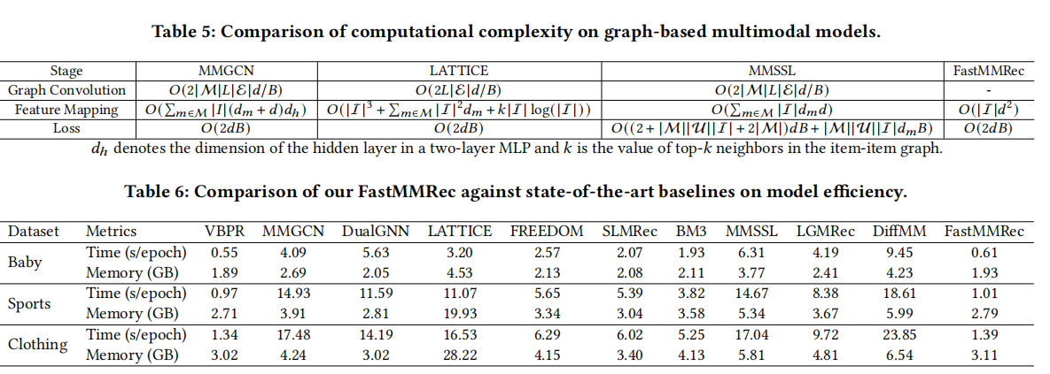
Experiment

Slide 13
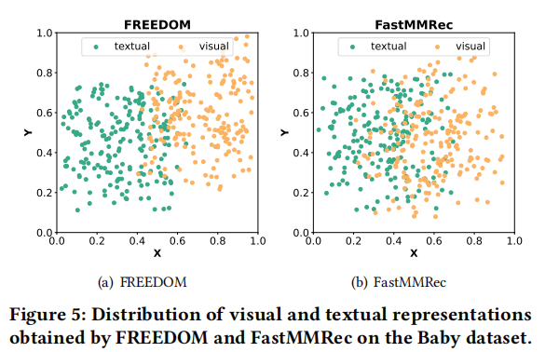
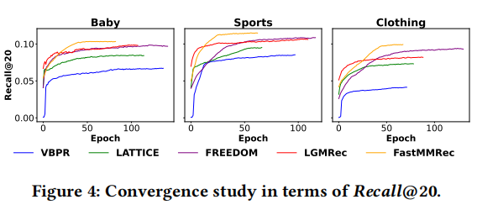
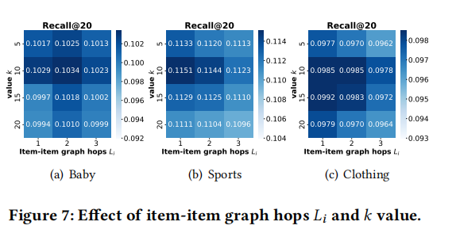
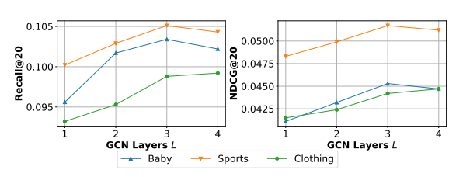
Experiment

Slide 14
Thank you!

